Slide 1
Algorithms, Flowchart and Mind Maps
By Probir Sir

Slide 2
Topics to be Covered
Algorithm
Writing an Algorithm
Flowchart
Drawing a Flowchart
Brainstorming
Mind Maps
Computer Languages
Language Translator

Slide 3
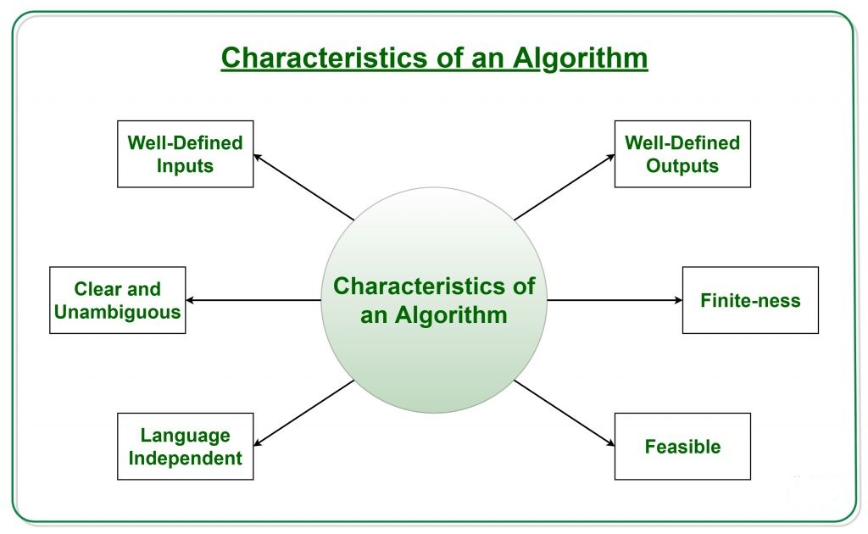
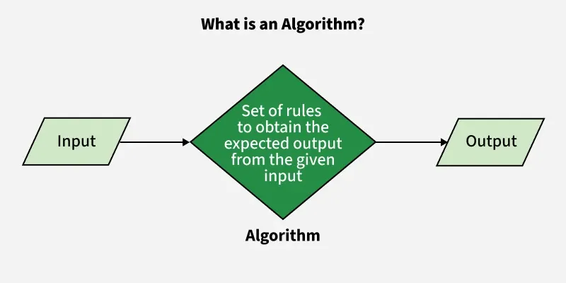
Algorithm
Key Characteristics of an Algorithm

Slide 4
Algorithm
Key Characteristics of an Algorithm
Step-by-step procedure: An algorithm provides a clear, logical sequence of actions to complete a task.
Input: It requires some form of input data to begin the process.
Processing: It performs operations on the input data in a specific order.
Output: It generates a result or the solution to the problem.
Finite: An algorithm must eventually terminate, providing a definitive end to the process.
An algorithm is a step-by-step set of instructions designed to solve a specific problem, perform a task, or carry out a calculation.
It takes input data, processes it through a series of well-defined operations, and produces a desired output.

Slide 5
Algorithm
Examples of Algorithms
Computer Programs:
A computer program is essentially an algorithm written in a language that a computer can understand and execute.
Navigation Systems:
These systems use algorithms to calculate the best route from one location to another by processing map data and traffic information.
Search Engines:
When you search for something online, algorithms process your query and the vast amount of data on the internet to deliver relevant results.
Everyday Tasks:
Following a recipe to bake a cake or sorting laundry into piles of different colors are both examples of algorithms that people use in their daily lives.
Uses of an algorithm: -
To solve problems
process data
Performing logical and mathematical calculations.
Manipulating data
Data sorting and searching.
machine learning and artificial intelligence

Slide 6
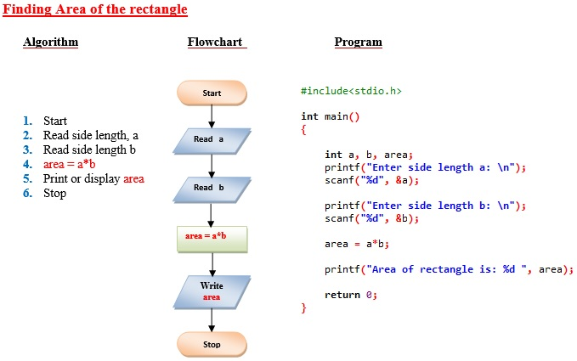
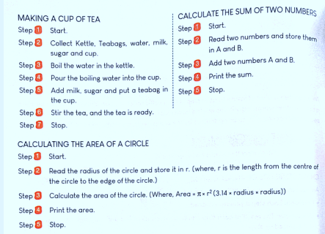
Algorithm
Examples of Algorithms

Slide 7
Flowchart
A flowchart is a diagram that uses standard shapes and connecting arrows to visually represent the steps, sequence, and decisions of a process, system, or workflow.
By providing a clear, logical sequence of actions in a shared visual language, flowcharts make complex processes easy to understand, document, analyse, and improve for various purposes, from planning to problem-solving.
Flowcharts serve as a powerful tool for: -
Visualization: To see a process or system at a glance.
Documentation: To record and explain procedures or workflows.
Planning: To outline steps for a project or task.
Decision-Making: To map out various options and outcomes.
Communication: To improve understanding of complex topics for different audiences.
Process Improvement: To identify bottlenecks, inefficiencies, and non-value-added steps.

Slide 8
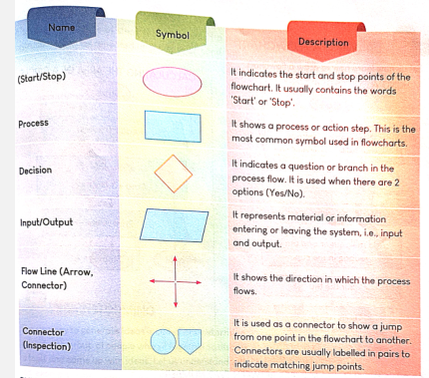
Flowchart
Key Components of a Flowchart
Symbols:
Standardized shapes represent different elements of a process, such as:
  Ovals or rounded rectangles: For the start and end points of a process.
  Rectangles: To show actions, processes, or functions.
  Diamonds: To represent decision points where different paths can be taken.
  Parallelograms: To denote input and output of data or materials.
Arrows:
Connect the symbols, showing the flow and direction of the steps and indicating the sequence of events.
Text:
Words or phrases within the shapes explain the specific step, action, or decision.

Slide 9
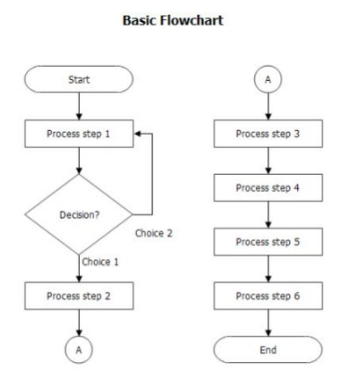
Flowchart
Rules for Drawing a Flowchart: -
Clear Start and End:
Every flowchart must have a clear starting point and at least one ending point.
Logical Sequence:
Arrange the steps in a clear, logical sequence, usually from top to bottom or left to right.
Flow Direction:
Ensure arrows point to indicate the flow of control, connecting one symbol to the next.

Slide 10
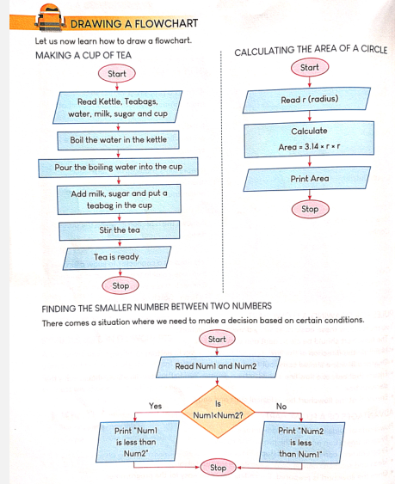
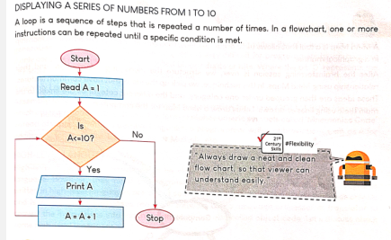
Flowchart

Slide 11
Brainstorming
How Brainstorming Works
Define the Problem/Topic:
A clear question or challenge is posed to guide the brainstorming session.
Encourage Free Flow of Ideas:
Participants are encouraged to voice all ideas, no matter how unusual, as the goal is quantity over quality at this stage.
No Criticism:
Criticism or judgment is strictly forbidden to create a psychologically safe environment where participants feel comfortable sharing without fear.
Build on Ideas:
Participants can use others' ideas as inspiration, combining concepts to create new solutions.
Record Ideas:
A scribe or shared digital space is used to record every idea, ensuring none are lost.
Evaluation Phase:
After the idea generation phase, the group shifts to a convergent thinking process to evaluate, refine, and select the most promising ideas for development.
Brainstorming is a creative technique, typically a group activity, to generate a large quantity of diverse ideas to solve a problem or develop a new concept, emphasizing free-thinking without judgment or criticism during the idea-generation phase.
The core principles are to focus on quantity of ideas, encourage unconventional thinking, build upon others' suggestions, and defer evaluation until later in the process to foster a safe, open environment for innovation.

Slide 12
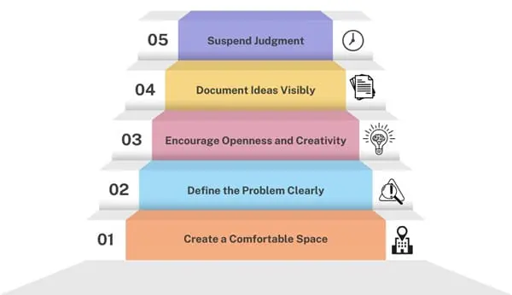
Brainstorming
Define the Problem/Goal.
Selecting the Time, Place and Process.
Introducing the facilitator.
Assessing ideas.
Processing results.

Slide 13
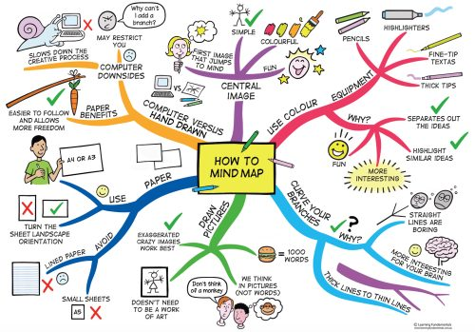
Mind Maps
Mind maps are visual diagrams that organize information hierarchically around a central concept, using colours, images, and keywords to represent ideas and show relationships.
They mimic natural brain patterns, promoting creativity and better recall by connecting information in a radial structure.
Key steps to creating one include starting with a central image or idea, adding main topics, connecting subtopics, and using visual elements like colours and symbols to enhance understanding and memory.

Slide 14
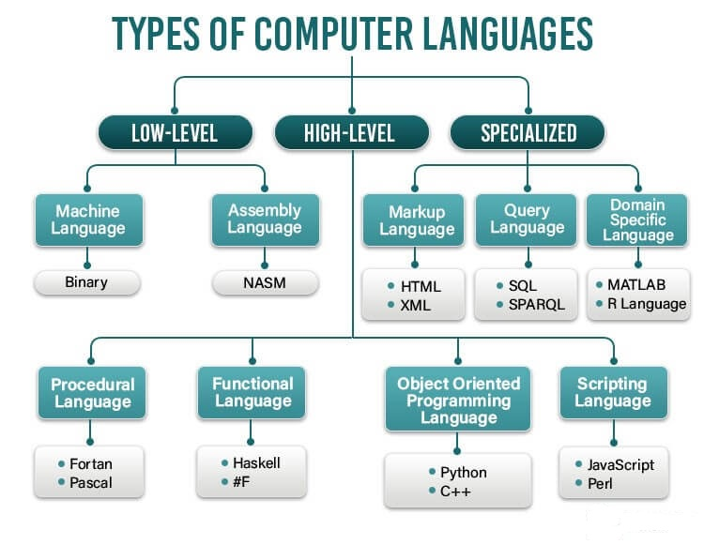
Computer Languages
A computer language is a formal set of instructions, symbols, and rules used to communicate with and control a computer, enabling humans to give instructions for tasks.
Computer languages are primarily categorized as low-level languages (machine language and assembly language), and high-level languages (like Java or Python),

Slide 15
Computer Languages
High-Level Languages
A high-level programming language (HLL) is a human-readable language with high abstraction from computer hardware, using natural language elements and computer science concepts to simplify programming and enhance portability.
High-level languages are categorized into two main types based on their execution method: compiled languages, like C++, that are fully translated into machine code before execution, and interpreted languages, such as Python, which are translated line-by-line at runtime.
Low-Level Languages
These languages provide little abstraction from the hardware and are designed for direct interaction with the computer's processor.
Machine Language: This is the binary language (0s and 1s) that the CPU directly understands and executes. It's the most fundamental level of communication with the computer.
Assembly Language: A step up from machine language, assembly language uses symbolic codes or mnemonics (like ADD for addition) to represent machine instructions. It is easier for humans to write than machine code but still must be translated by an assembler into machine language before the computer can run it.

Slide 16
Computer Languages
4th Generation Languages
A fourth-generation language (4GL) is a computer programming language designed to be closer to human language and more efficient for specific tasks, with its core purpose being increased productivity by simplifying common operations into single commands. Types of 4GLs are often domain-specific languages (DSLs), which are designed for a particular purpose like database querying or report generation. Key examples include SQL for databases, MATLAB for mathematical and scientific computing, and Python, which is used for data analysis and scripting.
3rd generation Languages
A 3rd level computer language, or Third-Generation Language (3GL), is a high-level, machine-independent programming language designed to be programmer-friendly, abstracting away machine details for easier code writing and debugging. Common types of 3GLs include procedural languages (like C and Pascal), object-oriented languages (like Java and C++), and scripting languages (like Python and JavaScript), though these classifications often overlap.

Slide 17
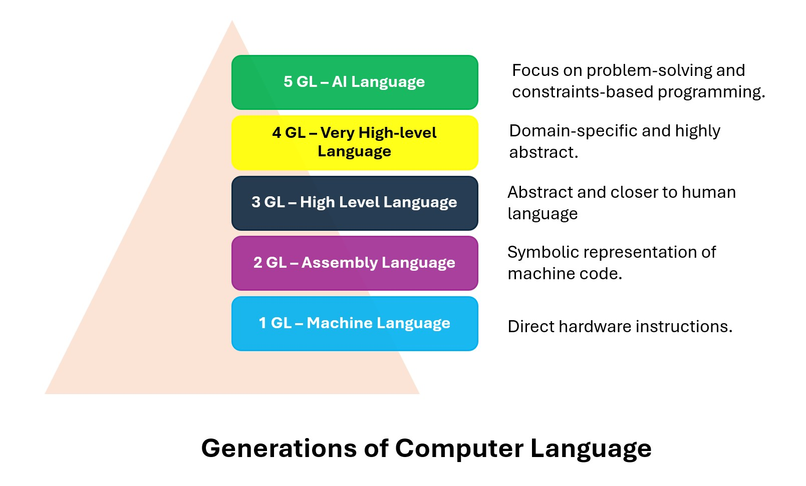
Computer Languages
5th generation Languages
A 5th generation language (5GL) is a computer language designed for artificial intelligence (AI) and problem-solving through constraints, rather than by explicit algorithmic instructions, allowing programs to learn and solve problems based on logical rules. Examples of 5GLs include Prolog, OPS5, and Mercury, which facilitate AI research and the development of constraint-based systems.

Slide 18
Language Translator
Programming Language Translators These are software programs that process code written in a high-level, human-friendly language and convert it into a low-level language or machine code that a computer's processor can understand and execute.
Compilers: Translate an entire program from source code into machine code all at once, creating an executable file. They are generally used after a program is finished and are faster for execution but require re-compilation after any changes.
Interpreters: Translate and execute code line by line. They are useful during the development phase, stopping the process if an error is found.
Assemblers: Translate assembly language, a low-level language, into machine code.

Slide 19


